Slide 1
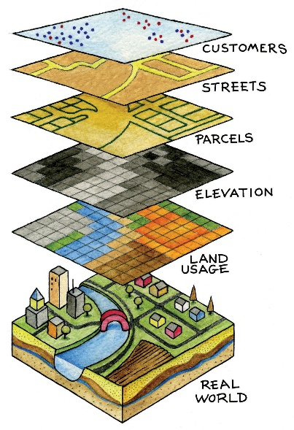
What is GIS?
An Introduction to Geographic Information Systems

Slide 2
Overview
What is a GIS?
How can we use it?
What is QGIS?
Map Types and Examples

Slide 3
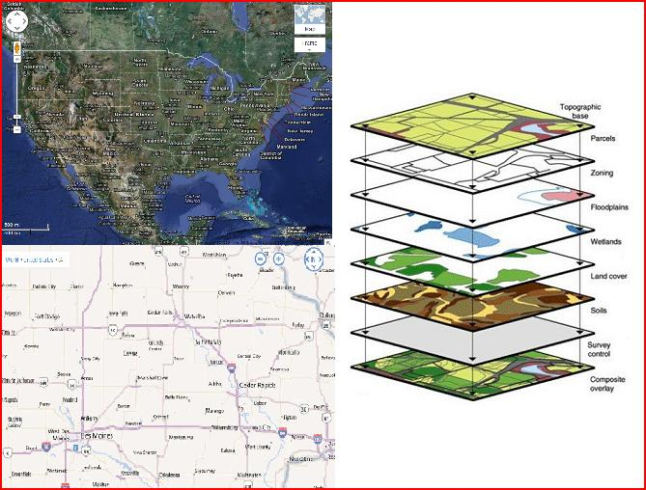
What is a GIS?
Geographic Information System: A system for storing, analyzing, and manipulating geographically referenced information on a computer.
Allows users to:
Investigate
Manage
Develop
Share spatial data

Slide 4
What is a Geographic Information System (GIS)?
The integration of computer hardware, software, and digitized data to display, manage, and analyze all forms of geographically referenced information.
Enables users to work with geographically referenced data in map form, revealing relationships, patterns, and trends in the dataset.
These relationships, patterns, and trends can cut across both time and space.

Slide 5
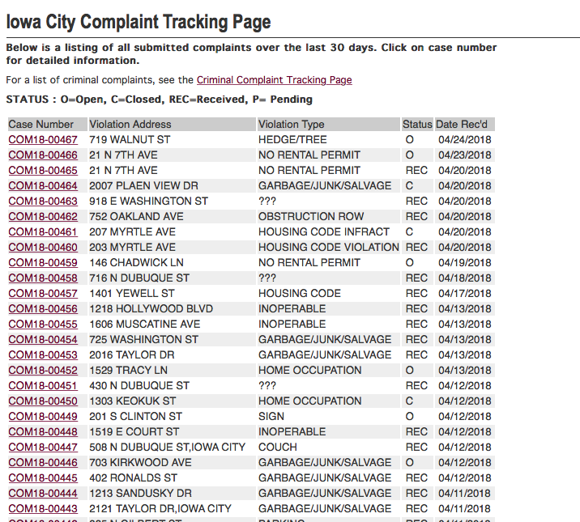

Slide 6
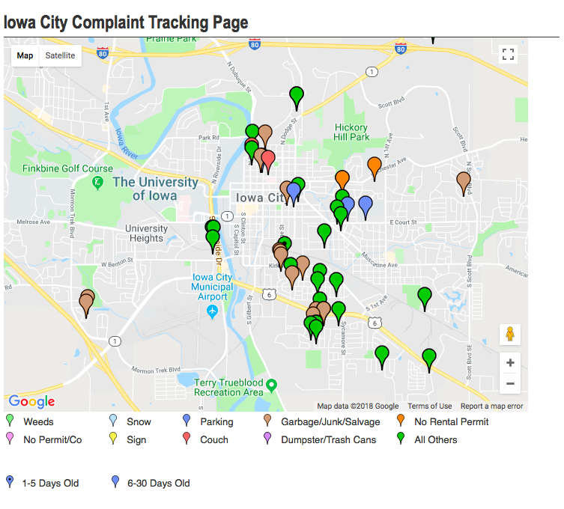

Slide 7
Three Types of Data
Spatial
Non-spatial/ attributes
Metadata
All three are important!
Spatial
Metadata
Non-spatial or
attributes
Notes:
Metadata is created and maintained as an integrated part of the data creation process — instead of something that might get done at end of project, if time allows.
Metadata is a critical component of a complete data set. As such, it should never be viewed as a separate entity. It is and should remain an integral component of the data. No data set should be considered complete without a complete, well-written metadata record or records.
Without accompanying metadata, the fitness for use of any given data set is unknown, and its usefulness is significantly impaired.

Slide 8
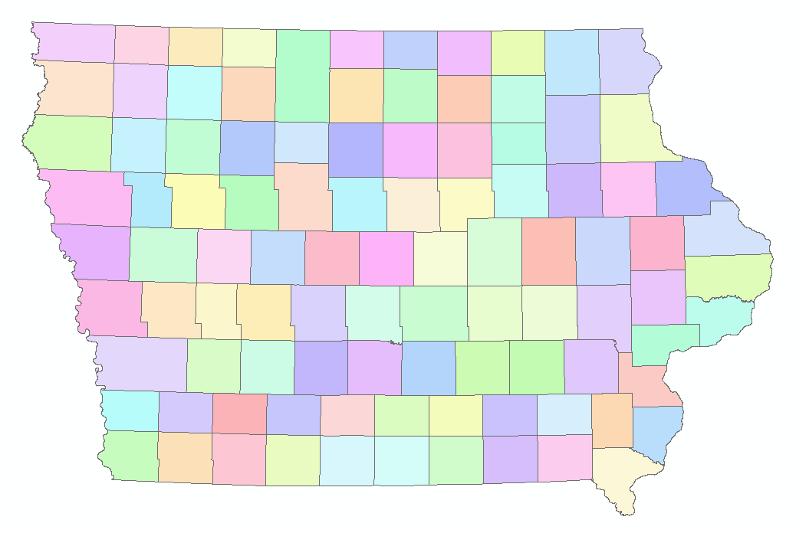
Spatial Data
Physical locations based on coordinates
Types:
Points
Lines
Polygons
Raster
Vector
Notes:
Metadata is a critical component of a complete data set. As such, it should never be viewed as a separate entity. It is and should remain an integral component of the data. No data set should be considered complete without a complete, well-written metadata record or records.
Without accompanying metadata, the fitness for use of any given data set is unknown, and its usefulness is significantly impaired.
Metadata is created and maintained as an integrated part of the data creation process — instead of something that might get done at end of project, if time allows.

Slide 9
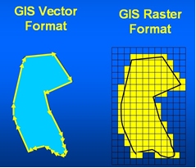
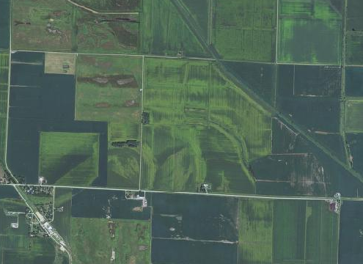
Maps contain a collection of layers that represent real-world objects
Types of Spatial Data
Vector: data stored as points, lines, or polygons
Raster: represents pixels within a grid (aerial imagery)

Slide 10
Vector Data (Shapefiles)
Shapefiles are made up of multiple vertex (vertices). Vertices are intermediate points along an object that reflect its shape. A vertex is the point at which a line changes direction or terminates.

Slide 11
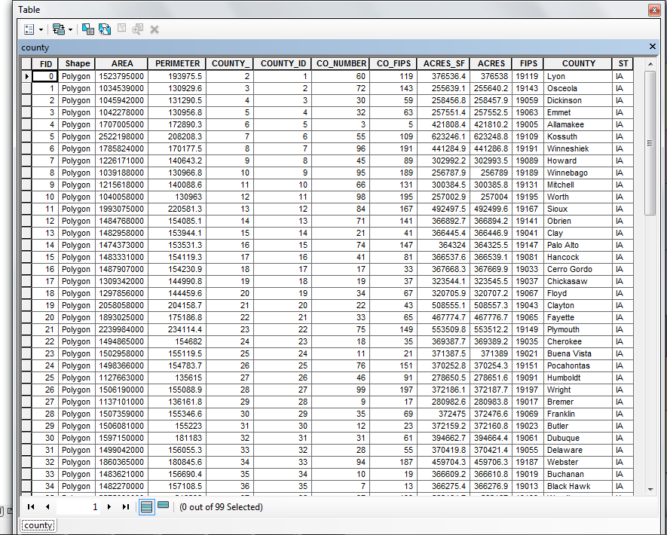
Non-Spatial Data
Names
Categories (eg. Residential/Commercial/Industrial/Agricultural)
Characteristics
Other Fields
Stored in an Attribute Table

Slide 12
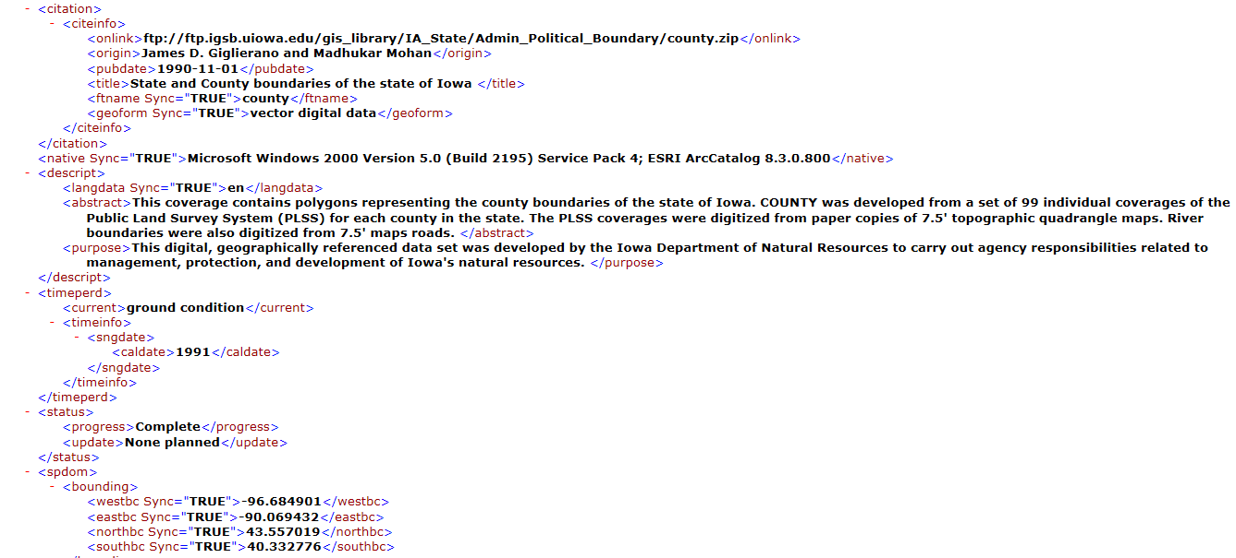
Metadata
Data about your data
Data sources
Projections
File types
Published date or last updated
Explains what your data is and how it can be used by you and your software
Critical for any GIS project
Notes:
Metadata is a critical component of a complete data set. As such, it should never be viewed as a separate entity. It is and should remain an integral component of the data. No data set should be considered complete without a complete, well-written metadata record or records.
Without accompanying metadata, the fitness for use of any given data set is unknown, and its usefulness is significantly impaired.
Metadata is created and maintained as an integrated part of the data creation process — instead of something that might get done at end of project, if time allows.

Slide 13
All three must work together!
Spatial
Metadata
Non-spatial or
attributes
Notes:
This is the power of GIS

Slide 14
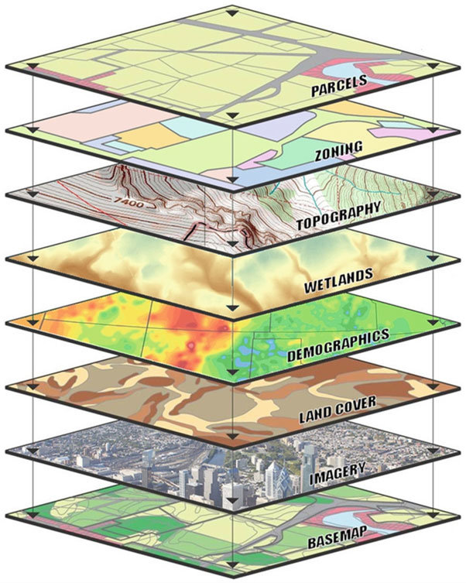
GIS Map Layers
GIS layers are unique because they combine information and geographic features.

Slide 15
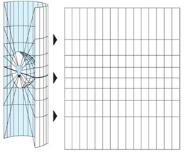
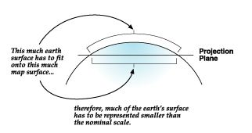
Projection
Maps represent the 3-D world in 2-D space
There are hundreds of projections that attempt to represent this
No one projection can preserve all qualities of the world: shape, area, direction, and distance

Slide 16
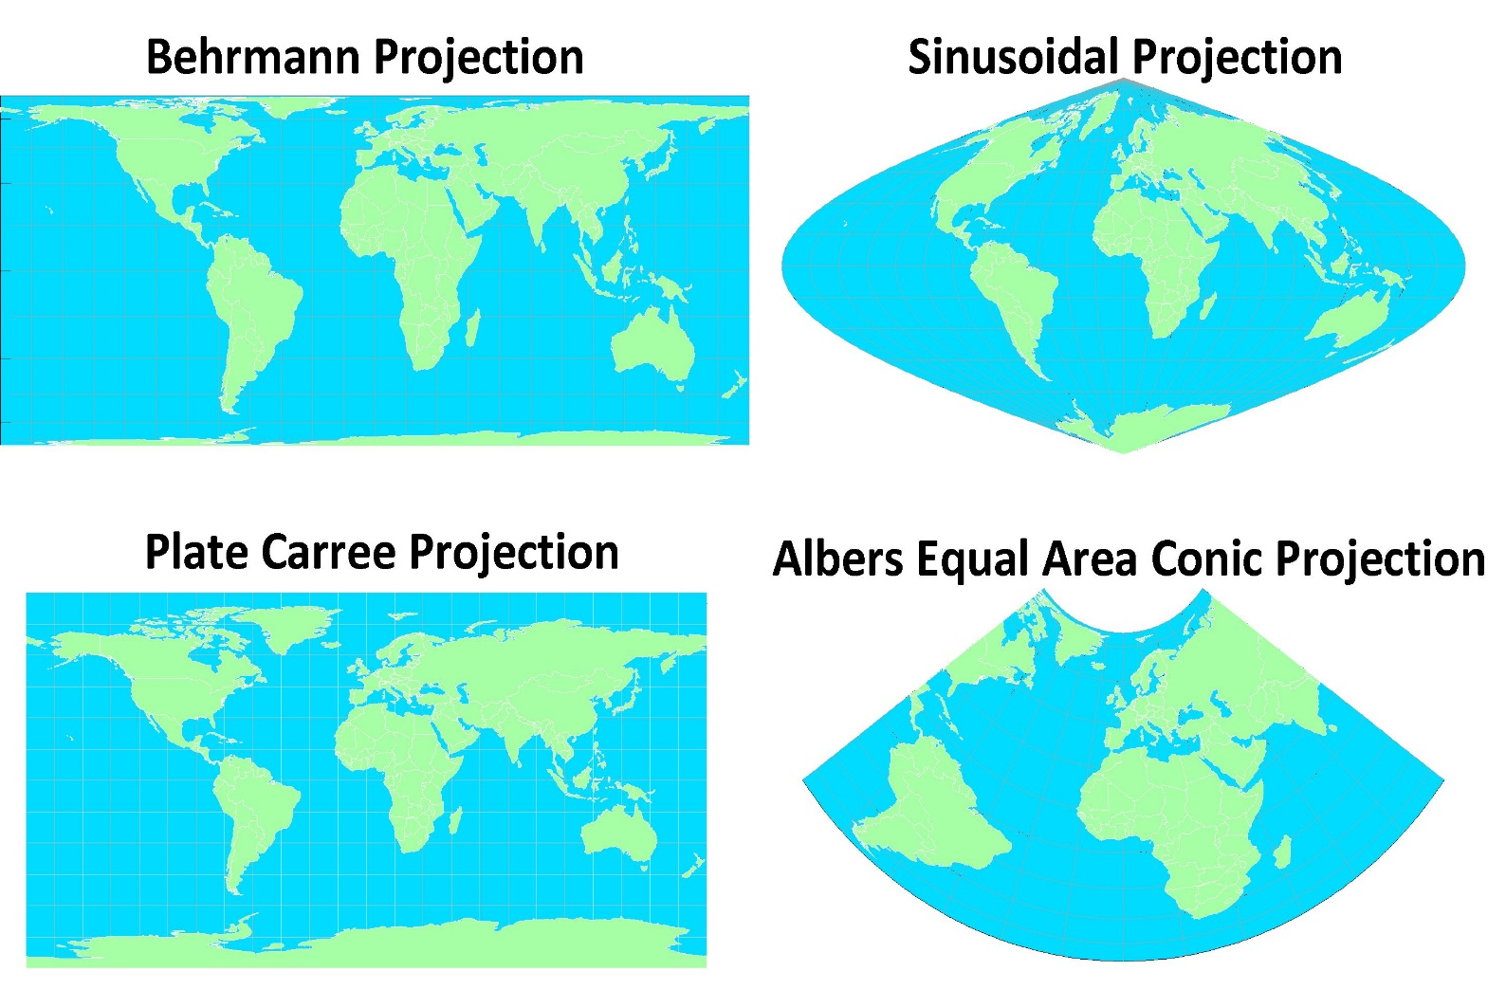
Four World Map Projections
Image From: http://personal.frostburg.edu/esblankenship0/EricMaps.htm

Slide 17
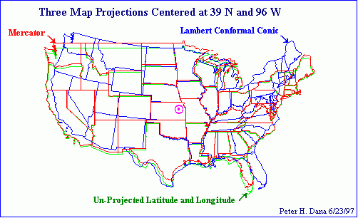
The picture below illustrates the similarities and differences of the three different projections. This image demonstrates the importance of defining the projection.

Slide 18
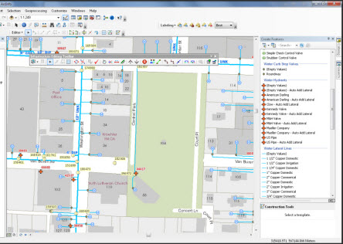
GIS Applications
Transportation
Where should we build roads/bike paths to alleviate traffic congestion?
New bus routes
Delivery companies – optimizing drop offs
Law Enforcement
9-1-1 routing
Crime "heat mapping"
Environmental/Conservation
Forestry
Geology
Hydrology
Utility Management
wastewater/stormwater management systems, phone, gas, and electric companies

Slide 19
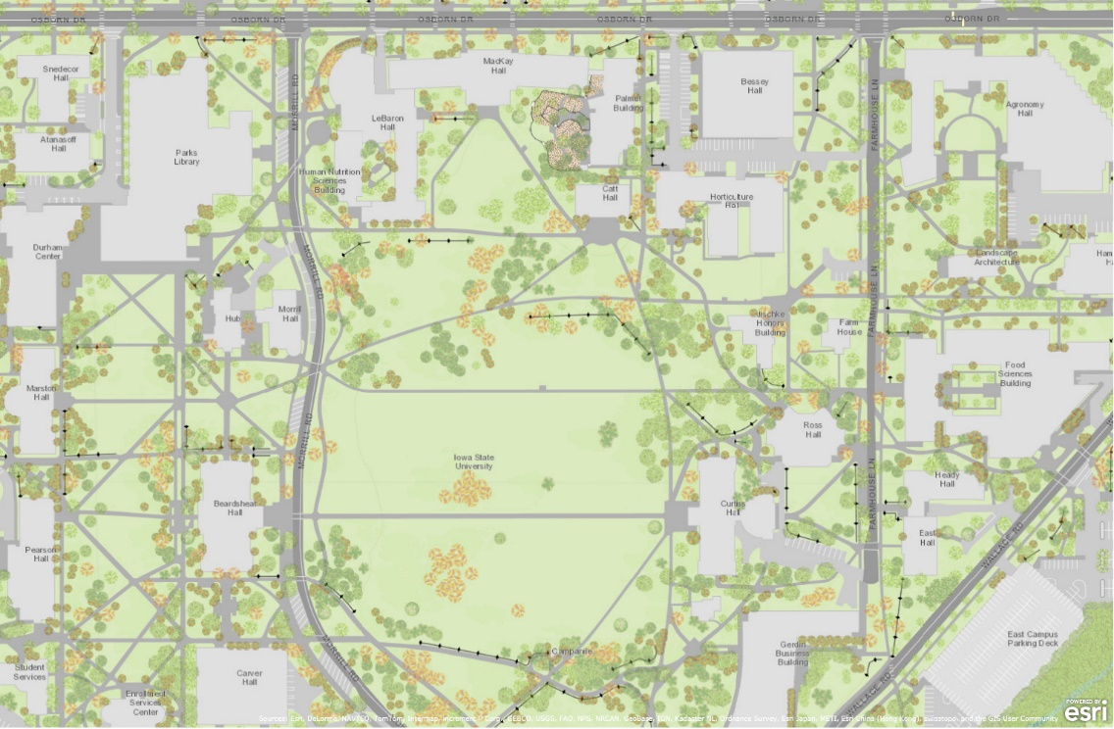
GIS Applications
Public Health
Environmental justice concerns – cumulative burden
Medical deserts
Planning
Zoning and Land Use
Public Input
Agriculture
Crop acreage
Pesticide/herbicide applications
Precision ag.

Slide 20
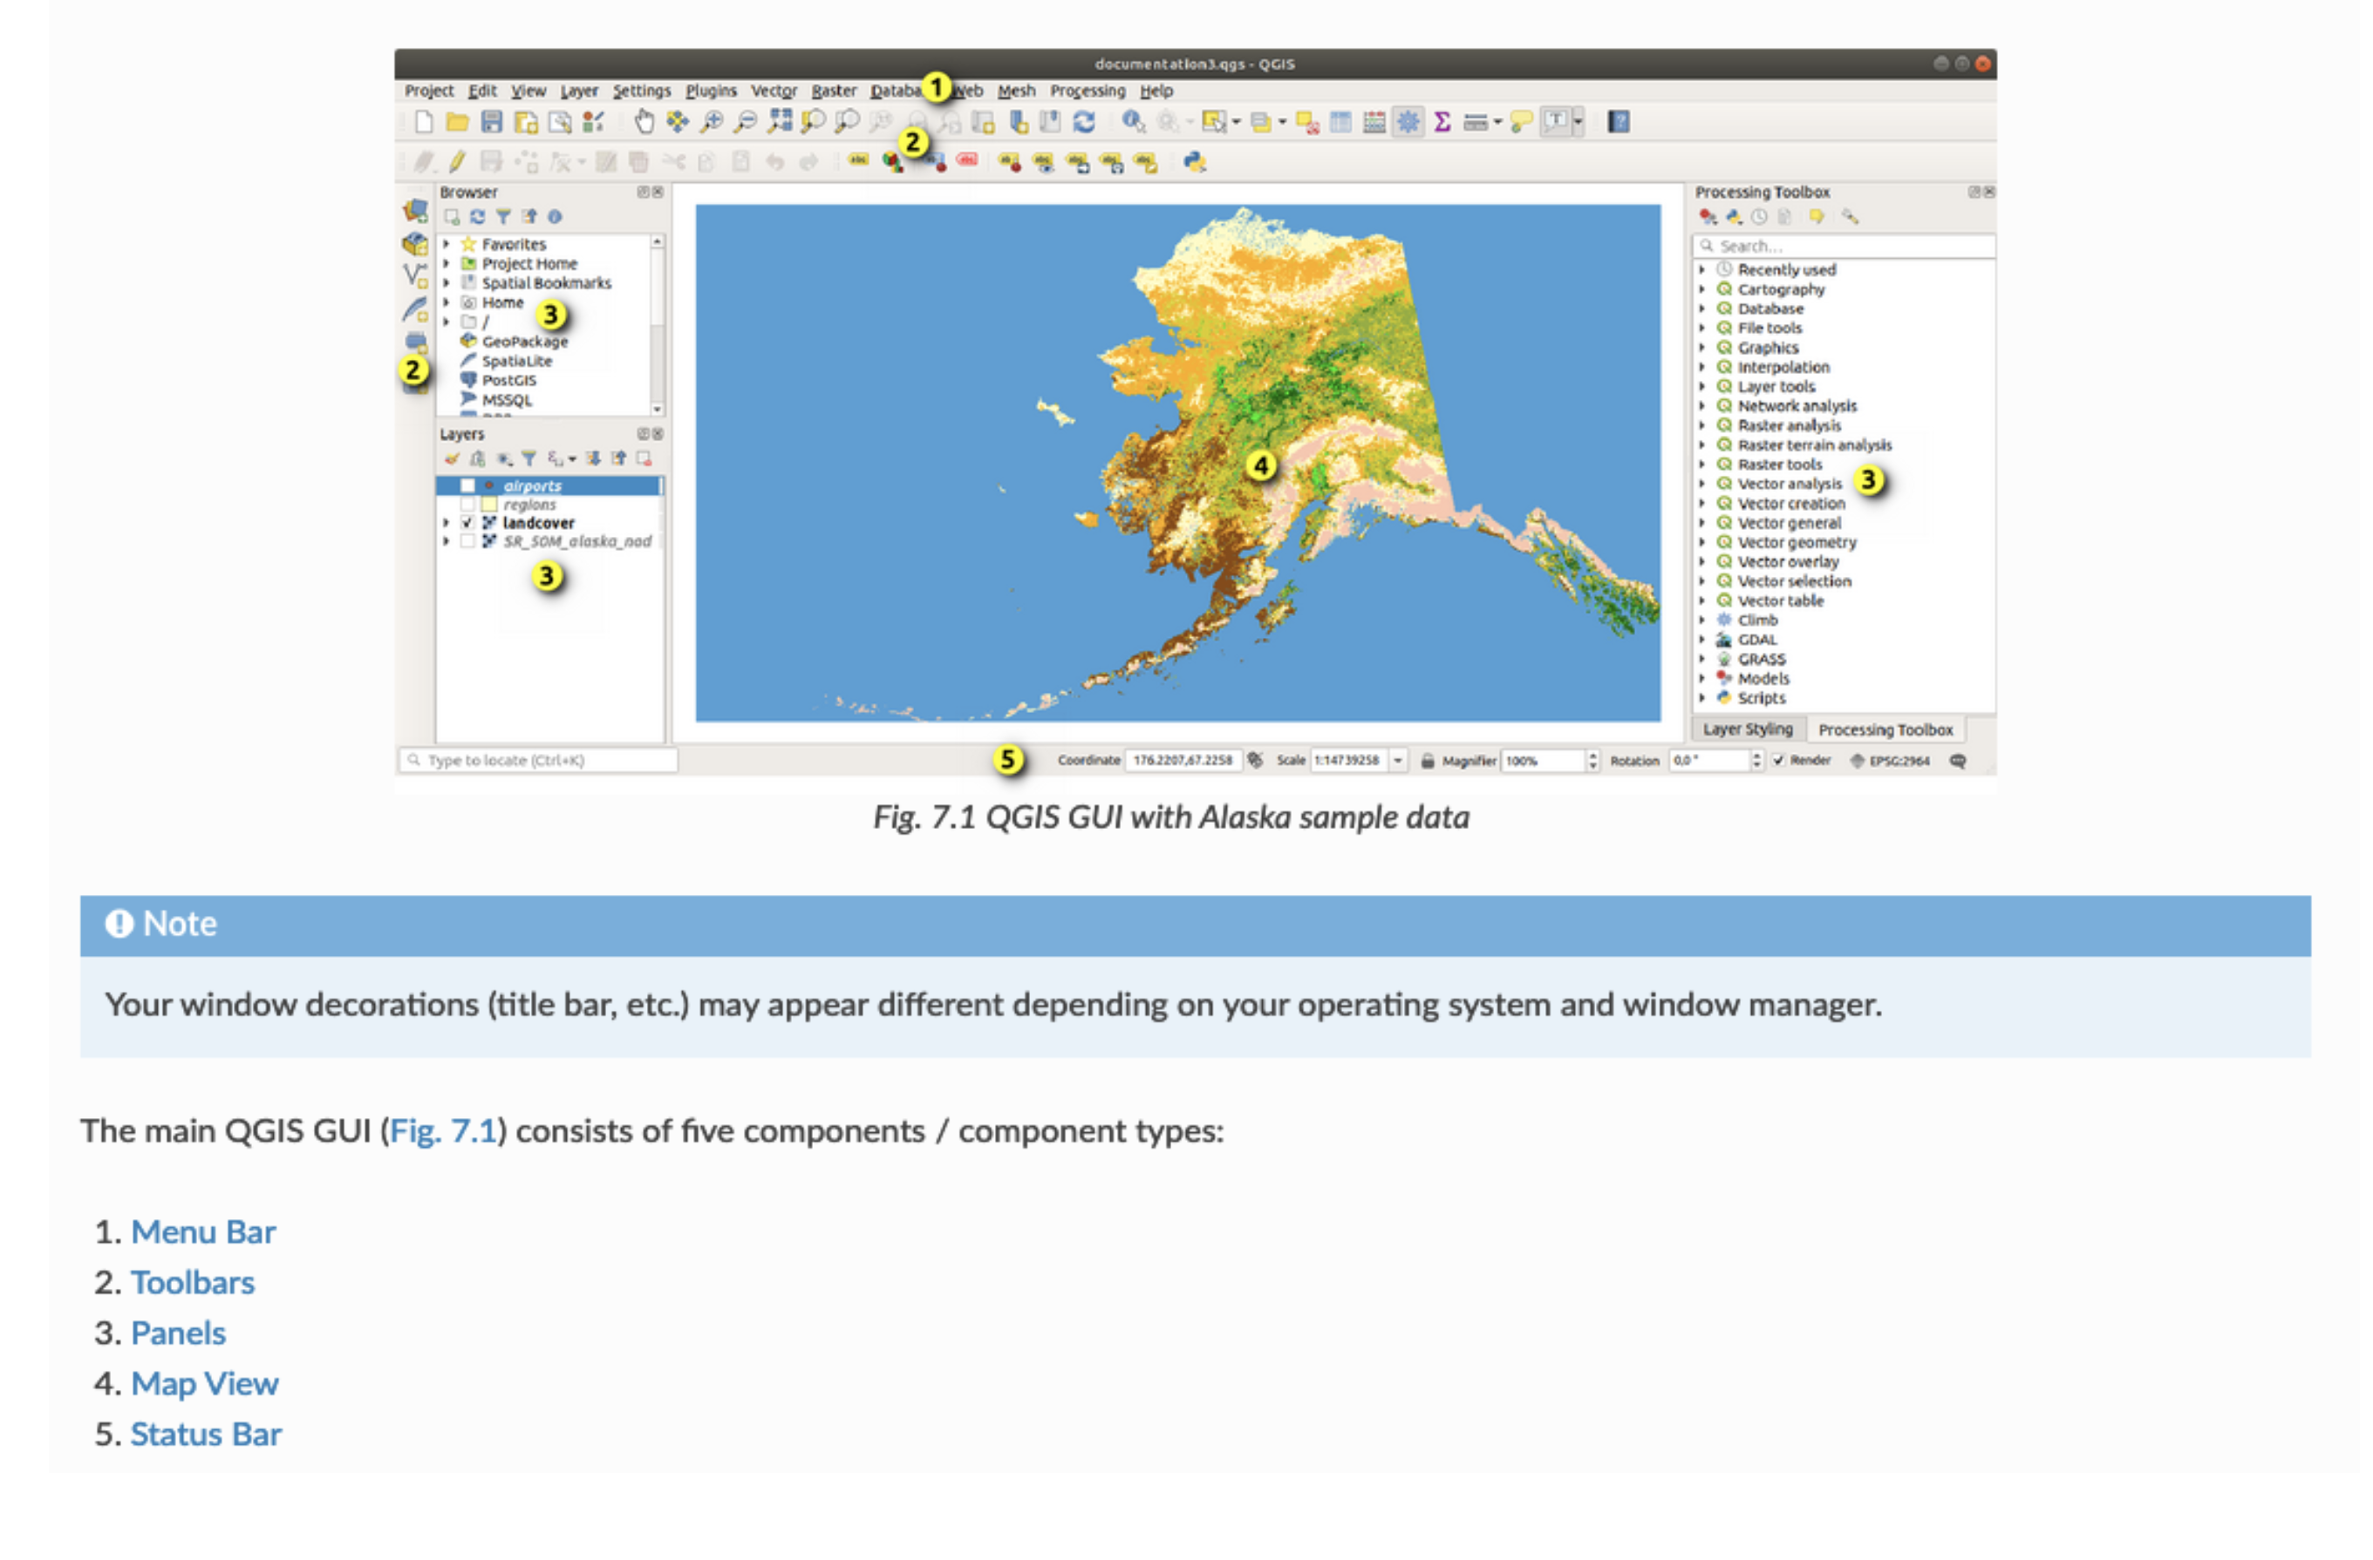

Slide 21


Slide 22
Contact Information
Christopher Seeger
Iowa State University Extension and Outreach
Community and Economic Development
cjseeger@iastate.edu

